Slide 1
How to create a website
wordpress

Slide 2
Agenda
What is a website?
What is domain name?
About Web hosting companys
CMS
Wordpress
SSL certificate
Content marketing

Slide 3
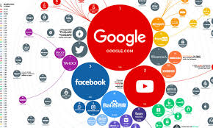

What is website?
A group of World Wide Web pages usually containing hyperlinks to each other and made available online by an individual, company, educational institution, government, or organization.
In a simple way a website provides a quick and easy way of communicating information between buyers and sellers. You can list your opening hours, contact information, show images of your location or products, and use contact forms to facilitate enquiries from potential customers or feedback from existing ones.

Slide 4
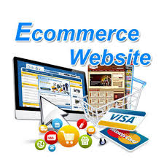
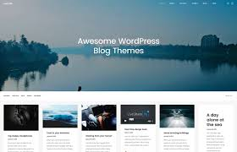
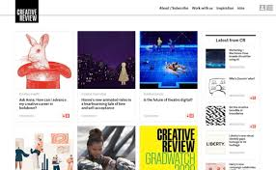
There are 8 different types of websites
Homepages
Magazine websites.
E-commerce websites.
Blogs.
Portfolio websites.
Landing pages.
Social media websites.
Directory and contact pages.
To create a webpage you need a domain name.

Slide 5
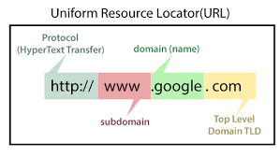
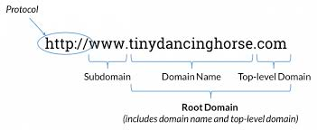
What is a domain name?
A domain name is a web address (e.g. www.yourbusinessname.com.au) that allows us to have a professional presence on the internet.
There are different types of domain names. Some have special requirements, while others are less strict.

Slide 6
Register your domain name
Your domain name should reflect your products or services so that your customers can easily find your business through a search engine. Your customers may also expect your domain name to be similar to your business name.
Your domain name will also be used for your email address. While you can use a free email address such as hotmail, sending emails from a business address looks more professional.
Remember to note when your domain name will need renewing so it doesn't expire. Letting your domain name expire could leave your business vulnerable to cybercriminals.

Slide 7


Find web hosting company
You will need to find a web hosting company to get your domain name on the internet.
They can also provide you with multiple email addresses.
Monthly fees for web hosting vary depending on how large your website is and how many visits you get.

Slide 8
Build your website
While building your own website you can have a professional web developer to help. Websites need to be kept up to date, so make sure you plan for ongoing maintenance.
We can use a website publishing package to build your own website. These are similar to word processors, but also have inbuilt features to convert your text and images to web content and send it to your website.like html or java scripts
You can build your website by use of CMS

Slide 9
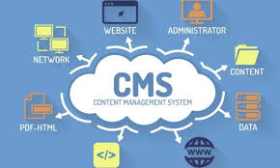

Create your website with a CMS
CMS or Content Management System (CMS) is more complex. In principle, they work as an online publisher, but in fact, they are not much more complicated to use.
With an online publisher, you can not only easily insert content, such as text and images, but also design the entire site. A traditional CMS is much more limited in this respect and the appearance of the site depends primarily on the predefined model you choose.
Examples:WordPress,(Joomla and Drupal)

Slide 10
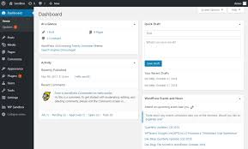
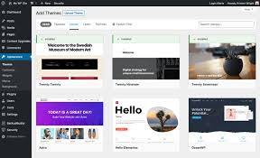
What is wordpress
WordPress is a website builder and content management system. It is an open source software that anyone can use to make any kind of website imaginable.WordPress is easy to use and it can be a beginner-friendly platform.

Slide 11
A major advantage, especially at WordPress: the thousands of plug-ins available. These extensions provide the site with features that are not offered by default. For example, the WooCommerce plug-in allows you to add a complete online store to your site. As WordPress is designed by default for only one language, installing a plug-in like WPML will allow publishing a translated version of the site. Yoast’s SEO plug-in is also very popular. It makes it possible to configure all the parameters in order to optimize the site for the search engines.
Advantages of CMS
Advantages:
Free choice of the host
Great for multilingual sites
Virtually no technical limitations imposed by the service
Ability to add plugins to enrich the site
Disadvantages:
No global assistance
The freedom of creation depends on the theme used
Paid plugins can drive up costs

Slide 12
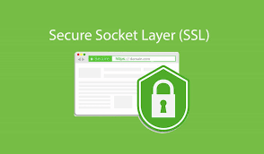
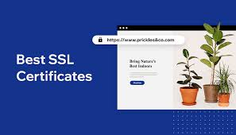
Ssl certification
A SSL certificate is a digital certificate that authenticates a website's identity and enables an encrypted connection. SSL stands for Secure Sockets Layer, a security protocol that creates an encrypted link between a web server and a web browser
It is a bit of code on your web server that provides security for online communications. When a web browser contacts your secured website, the SSL certificate enables an encrypted connection. It's kind of like sealing a letter in an envelope before sending it through the mail.

Slide 13
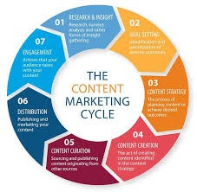

Content marketing
It is a strategy based on the distribution of relevant and valuable content to a target audience.
As in any marketing strategy, the goal of content marketing is to attract leads that ultimately convert into customers. But it does so differently than traditional advertising. Instead of enticing prospects with potential value from a product or service, it offers value for free in the form of written material.

Slide 14
Useful tips for creating a website
1)Think about what your customers want to know, not just what you want to tell them.
2)Use professionals to help you. An unprofessional website can potentially put customers off.
3)Update your website regularly, especially if you include information about your prices.
4)Make sure your contact details are correct and easy for your customers to find.
5)Promote your website in your marketing material and include it on your business cards.
6)Find out how you can make your website easy for search engines, such as Google, to find. This is called search engine optimisation (SEO).

Slide 15


